Slide 1
Descriptive Statistics
Kevin Pamilagas

Slide 2
Why Descriptive Statistics?

Slide 3

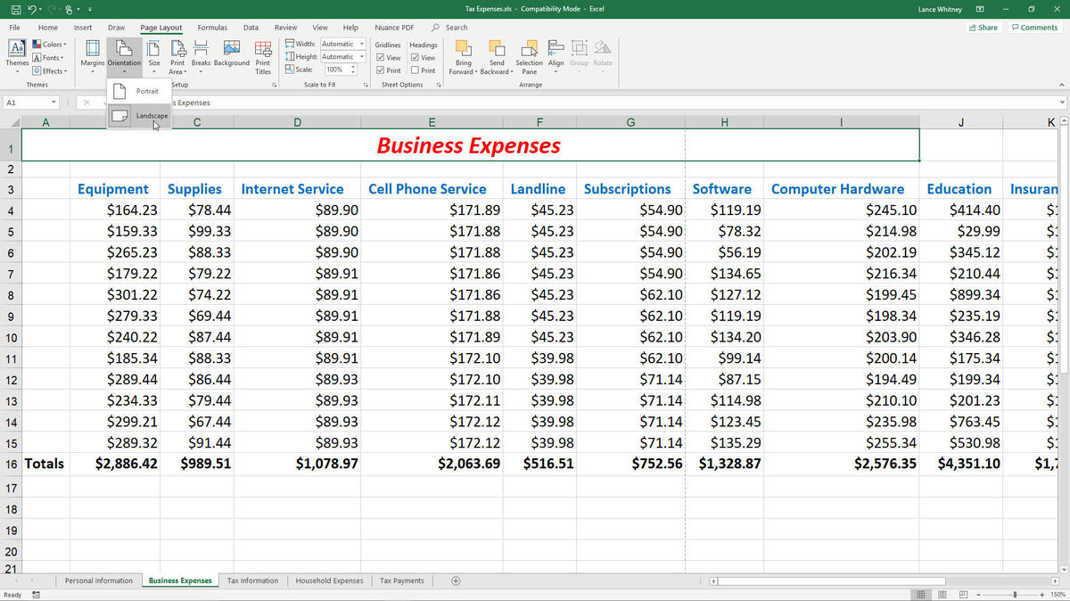
Why Descriptive Statistics?

Slide 4

Why Descriptive Statistics?

Slide 5
Descriptive Statistics
“Descriptive statistics implies a simple quantitative summary of a data set that has been collected. It helps us understand the experiment or data set in detail and tells us everything we need to put the data in perspective.”
-Lyndsay T. Wilson

Slide 6
Descriptive Statistics

Slide 7
Descriptive Statistics
Measures of:

Slide 8
Descriptive Statistics
Measures of:
Central Tendency

Slide 9
Descriptive Statistics
Measures of:
Central Tendency
Dispersion

Slide 10
Descriptive Statistics
Measures of:
Central Tendency
Dispersion

Slide 11
Measures of Central Tendency

Slide 12
Measures of Central Tendency
“Center” of the data

Slide 13
Measures of Central Tendency
“Center” of the data
Measures:

Slide 14
Measures of Central Tendency
“Center” of the data
Measures:
Mean

Slide 15
Measures of Central Tendency
“Center” of the data
Measures:
Mean
Median

Slide 16
Measures of Central Tendency
“Center” of the data
Measures:
Mean
Median
Mode

Slide 17
Measures of Central Tendency - Mean

Slide 18
Measures of Central Tendency - Mean
“Average”

Slide 19
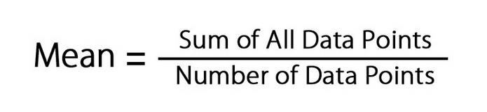
Measures of Central Tendency - Mean
“Average” =

Slide 20
Measures of Central Tendency - Mean
“Average” =
5, 1, 2, 3, 1 ,13, 8

Slide 21
Measures of Central Tendency - Mean
“Average” =
5, 1, 2, 3, 1 ,13, 8
5+1+2+3+1+13+8 7

Slide 22
Measures of Central Tendency - Mean
“Average” =
5, 1, 2, 3, 1 ,13, 8
5+1+2+3+1+13+8 7
= 4.71

Slide 23
Measures of Central Tendency - Median

Slide 24
Measures of Central Tendency - Median
“Middle”

Slide 25
Measures of Central Tendency - Median
“Middle”
5, 1, 2, 3, 1, 13, 8

Slide 26
Measures of Central Tendency - Median
“Middle”
1, 1, 2, 3, 5, 8, 13

Slide 27
Measures of Central Tendency - Median
“Middle”
1, 1, 2, 3, 5, 8, 13

Slide 28
Measures of Central Tendency - Median
“Middle”
1, 1, 2, 3, 5, 8, 13
3

Slide 29
Measures of Central Tendency - Median
“Middle”
1, 1, 2, 3, 5, 8

Slide 30
Measures of Central Tendency - Median
“Middle”
1, 1, 2, 3, 5, 8

Slide 31
Measures of Central Tendency - Median
“Middle”
1, 1, 2, 3, 5, 8
2.5

Slide 32
Measures of Central Tendency - Mode

Slide 33
Measures of Central Tendency - Mode
“Most” “Most” “Most”

Slide 34
Measures of Central Tendency - Mode
“Most” “Most” “Most”
1, 1, 2, 3, 5, 8

Slide 35
Measures of Central Tendency - Mode
“Most” “Most” “Most”
1, 1, 2, 3, 5, 8

Slide 36
Measures of Central Tendency - Mode
“Most” “Most” “Most”
1, 1, 2, 3, 5, 8
1

Slide 37
Measures of Central Tendency - Mode
“Most” “Most” “Most”
1, 1, 2, 2, 3, 5, 8

Slide 38
Measures of Central Tendency - Mode
“Most” “Most” “Most”
1, 1, 2, 2, 3, 5, 8

Slide 39
Measures of Central Tendency - Mode
“Most” “Most” “Most”
1, 1, 2, 2, 3, 5, 8
1 & 2

Slide 40
Example
At a bike sales shop, sales rep are paid commission on every bike that he or she sells. You ask the manager what the typical sales rep is paid. The manager is not sure but provides you with the commission for seven sales reps for the past week: $500, $1000, $50, $11000, $950, $50, $450.
Notes:
Fighters: F-22(Raptor), 16(Falcon), 35(Lightning), 18(Hornet), 15(Eagle)

Slide 41
Example
$50, $50, $450, $500, $950, $1000, $11000
Mean : $2000
Median: $500
Mode: $50

Slide 42
Which is best?
How do extreme values (high or low) affect the measures of central tendency?

Slide 43
Descriptive Statistics
Measures of:
Central Tendency
Dispersion

Slide 44
Descriptive Statistics
Measures of:
Central Tendency
Dispersion

Slide 45
Measures of Dispersion
“Spread” of data
Measures:
Range
Interquartile Range
Standard Deviation

Slide 46
Measures of Central Tendency - Range
Difference between the largest and smallest values
0, 1, 1, 2, 3, 5

Slide 47
Measures of Central Tendency - Range
Difference between the largest and smallest values
0, 1, 1, 2, 3, 5

Slide 48
Measures of Central Tendency - Range
Difference between the largest and smallest values
0, 1, 1, 2, 3, 5
5 - 0

Slide 49
Measures of Central Tendency - Range
Difference between the largest and smallest values
0, 1, 1, 2, 3, 5
5 - 0
5

Slide 50
Measures of Central Tendency - Interquartile Range
Range of the middle 50% of data
0, 1, 1, 2, 3, 5

Slide 51
Measures of Central Tendency - Interquartile Range
Range of the middle 50% of data
0, 1, 1 2, 3, 5

Slide 52
Measures of Central Tendency - Interquartile Range
Range of the middle 50% of data
0, 1, 1 2, 3, 5

Slide 53
Measures of Central Tendency - Interquartile Range
Range of the middle 50% of data
0, 1, 1 2, 3, 5
3 - 1

Slide 54
Measures of Central Tendency - Interquartile Range
Range of the middle 50% of data
0, 1, 1 2, 3, 5
3 - 1
2

Slide 55
Measures of Central Tendency - Interquartile Range
Range of the middle 50% of data
0, 1, 1, 2, 3, 5, 8

Slide 56
Measures of Central Tendency - Interquartile Range
Range of the middle 50% of data
0, 1, 1, 2, 3, 5, 8

Slide 57
Measures of Central Tendency - Interquartile Range
Range of the middle 50% of data
0, 1, 1 2 3, 5, 8

Slide 58
Measures of Central Tendency - Interquartile Range
Range of the middle 50% of data
0, 1, 1 2 3, 5, 8

Slide 59
Measures of Central Tendency - Interquartile Range
Range of the middle 50% of data
0, 1, 1 2 3, 5, 8
5 - 1

Slide 60
Measures of Central Tendency - Interquartile Range
Range of the middle 50% of data
0, 1, 1 2 3, 5, 8
5 - 1
4

Slide 61


Measures of Central Tendency - Standard Deviation
“Deviation” around the mean

Slide 62
Measures of Central Tendency - Standard Deviation
x

Slide 63
Measures of Central Tendency - Standard Deviation
x
0
1
1
2
3
5

Slide 64
Measures of Central Tendency - Standard Deviation
x | x - x̅
0
1
1
2
3
5
X̅ = 2

Slide 65
Measures of Central Tendency - Standard Deviation
x | x - x̅
0 | -2
1 | -1
1 | -1
2 | 0
3 | 1
5 | 3
X̅ = 2

Slide 66
Measures of Central Tendency - Standard Deviation
x | x - x̅ | (x - x̅)²
0 | -2
1 | -1
1 | -1
2 | 0
3 | 1
5 | 3
X̅ = 2

Slide 67



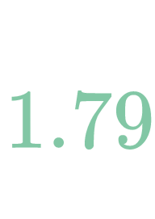
Measures of Central Tendency - Standard Deviation
x | x - x̅ | (x - x̅)²
0 | -2 | 4
1 | -1 | 1
1 | -1 | 1
2 | 0 | 0
3 | 1 | 1
5 | 3 | 9
X̅ = 2

Slide 68
Example
At a bike sales shop, sales rep are paid commission on every bike that he or she sells. You ask the manager what the typical sales rep is paid. The manager is not sure but provides you with the commission for seven sales reps for the past week: $50, $50, $450, $500, $950, $1000, $11000.

Slide 69
Example
$50, $50, $450, $500, $950, $1000, $11000
Range: $10950
Interquartile Range: $950
Standard Deviation: $3990

Slide 70
Which is best?
Range
Pros: 1. Easy to calculate
Cons: 1. Doesn’t use all the information 2. Sensitive to extreme values 3. Min and max are more useful

Slide 71
Which is best?
Interquartile Range
Pros: 1. Good for ordered data 2. Not susceptible to extreme values 3. More stable than range
Cons: 1. Doesn’t use all the information 2. Harder to calculate and understand

Slide 72
Which is best?
Standard Deviation
Pros:
1. Uses all the data values 2. Useful in statistical methods and inference
Cons: 1. Susceptible to extreme values 2. Hard to calculate manually

Slide 73
So what?
Use both measures to describe data
One does not tell you enough

